Slide 1
Hybrid Cache
Deep dive into .NET Caching

Slide 2
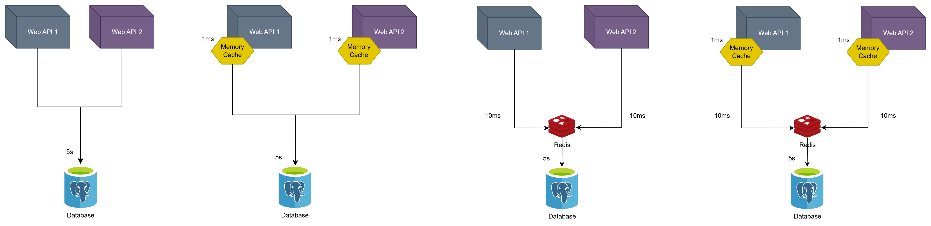
From No-Cache to Hybrid-Cache
No Cache
Memory Cache (L1)
Distributed Cache (L2)
Hybrid Cache (L1 + L2)

Slide 3
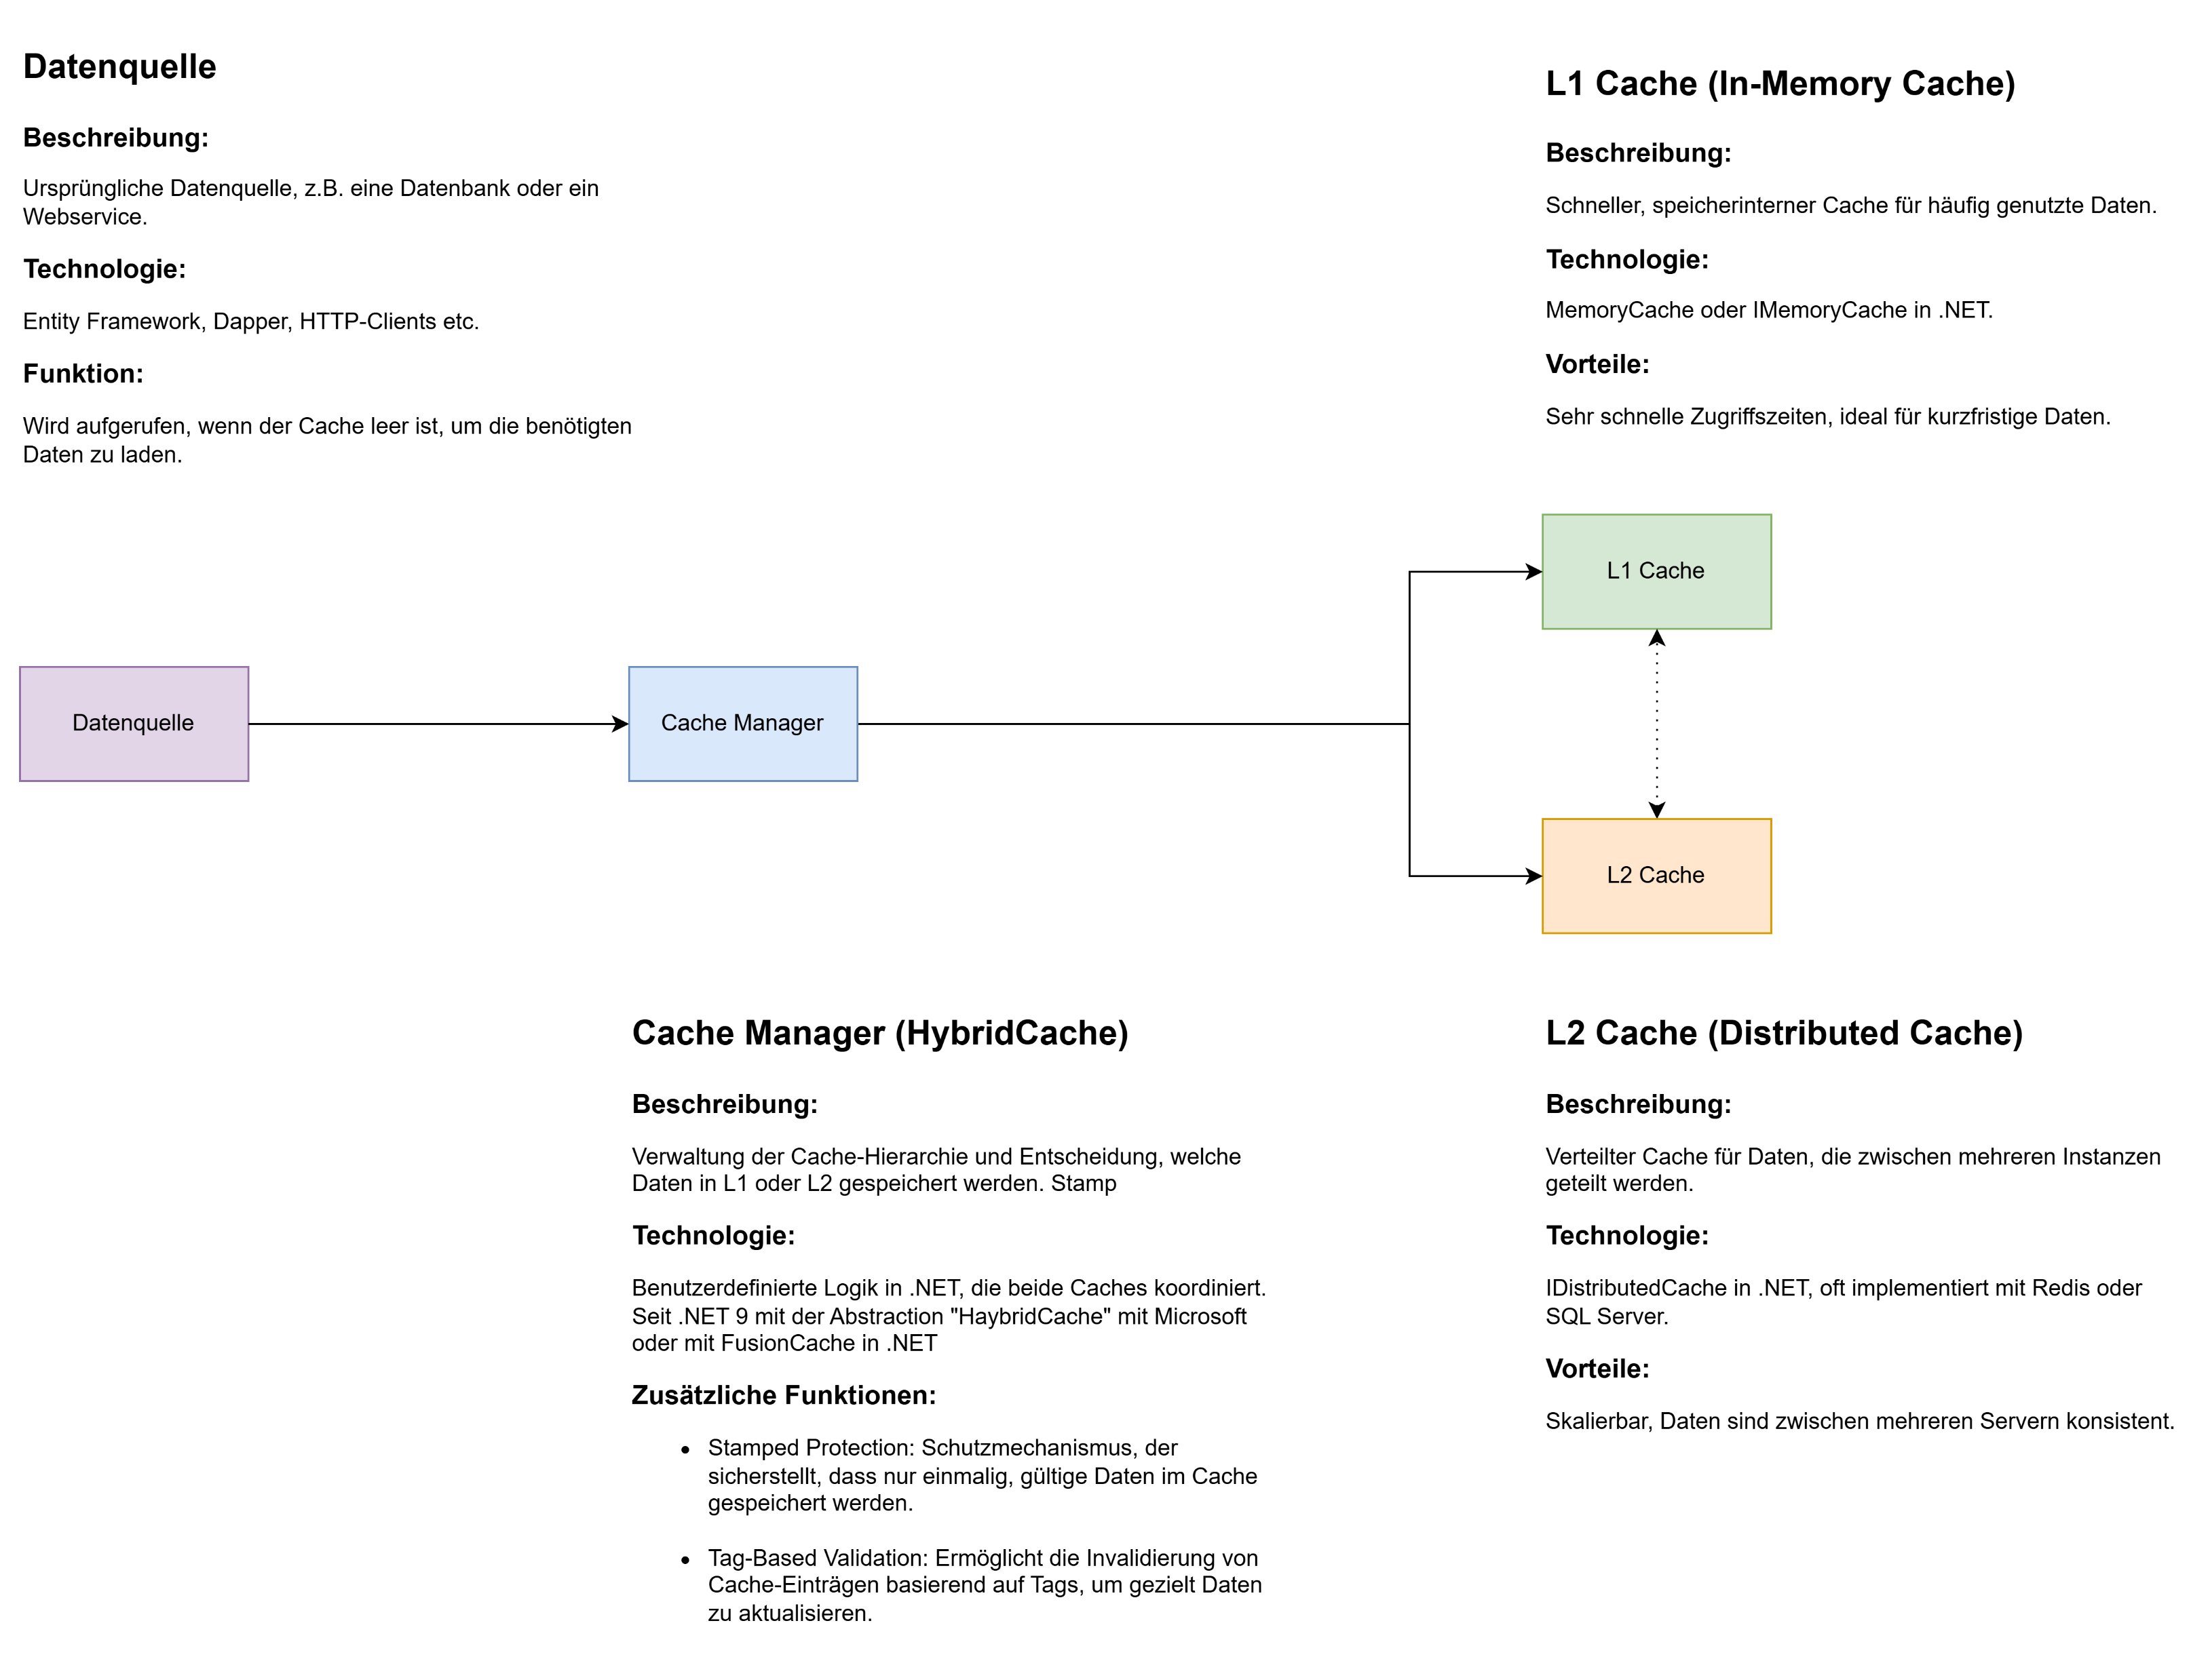
Process and Architecture

Slide 4

Demo

